Slide 1
The University Corporation
First Time Home Buyer’s Seminar
Linda Turner – Associate Director, Real Estate
Wells Fargo Mortgage Team
Robert J. Carlson – Real Estate Attorney
Stewart Title of California – Title and Escrow

Slide 2
GETTING STARTED
&
ROLE OF YOUR
REAL ESTATE AGENT
Linda Turner
Associated Director, Real Estate
The University Corporation

Slide 3
Am I Ready To Buy a Home?
Do you have steady income (usually a job)?
Do you have good record of paying your bills
Do you have FEW outstanding Long-term debts, like car payments?
Do you have money saved for a down payment?
Do you have the ability to pay a mortgage every month, plus additional costs?

Slide 4
HOW DOES RENTING COMPARE
TO OWNING A HOME
They don’t really compare at all….
Renters are Free of Most Maintenance
Renters lose chance to build equity
Lose Tax benefits
You get rent increases
How about decorating?

Slide 5
IF YOU OWN YOUR HOME
MAKE A MORTGAGE PAYMENT…BUT
YOUR ARE BUILDING YOUR EQUITY
QUALIFY FOR TAX BENEFITS
FREEDOM…STABILITY AND SECURITY

Slide 6
GETTING READY
PUT YOUR CREDIT IN ORDER
PAY DOWN DEBT
DETERMINE WHAT YOU CAN AFFORD
SAVE UP FOR A DOWN PAYMENT
CONSIDER WHETHER YOU REALLY SHOULD BUY A HOME

Slide 7
HOW DO I BEGIN THE PROCESS OF
BUYING A HOME
Where do you want to live?
How Much can you afford
in a monthly mortgage payment?

Slide 8
PROCESS OF BUYING
How much space do you need?
Closeness to certain schools?
Community Resources
  Local Library
  Parks
  Stores

Slide 9
KNOWLEDGE
REMEMBER KNOWLEDGE IS SAID TO OPEN DOORS. THIS IS LITERALLY TRUE WHEN IT COMES TO BUYING A HOME!

Slide 10
READY TO SHOP!!!
HIRING YOUR REALTOR (BUYER’S AGENT)
GET PRE-APPROVED
CONTACT A BANK OR MORTGAGE LENDER

Slide 11

REASONS TO HIRE A REAL ESTATE AGENT
WHAT IS THE ROLE OF YOUR REAL ESTATE AGENT???????

Slide 12
REASONS TO HIRE A
REAL ESTATE AGENT
Agents are Buffers
Possess knowledge of neighborhoods

Slide 13
REASONS TO HIRE A REAL ESTATE AGENT (CONT’D)
Guide to other Professionals
  Physical Inspectors
  Plumbers
  Electricians

Slide 14
#1 ROLE OF YOUR
REAL ESTATE AGENT
FIDUCIARY RESPONSIBILITY
A Real Estate Agent’s Fiduciary Responsibility Is To Look Out For Your BEST Interests FIRST!!!

Slide 15
What is the role of your real estate agent?
Negotiate on your behalf
Fight for the sale price, terms and condition
Tell you the truth at all time
Anticipate problems
Disclose defects
Provide all necessary documentation
Help you through escrow and loan process

Slide 16
What are good characteristics of great buyer’s agent?
A very good listener
Patient and Compassionate
Problem solver
Dedicated to figuring out what you want and delivering it
Loves showing homes
Comes up with ideas for improving a home if it’s a fixer
Detail oriented and organized

Slide 17
GOOD CHARACTERISTICS
Excellent follow-up
Keen insight for the rock-bottom price
PROFESSIONAL and Polite
Gets along well with others

Slide 18

Finding a real estate agent
Should you work with the Seller’s Agent?

Slide 19
Buyer’s Representation
Called: Buyer’s Agent
Buyer’s Broker Agreement

Slide 20
Buyer Broker Agreement
Exclusive Right to Represent
The Agreement terms – 3 months – 1 yr
The buyer cannot hire more than one broker/agent to represent her/him
The buyer is not responsible for the commission if another party (seller) pays it
Broker/Agent can negotiate with unrepresented Sellers on buyer’s behalf

Slide 21
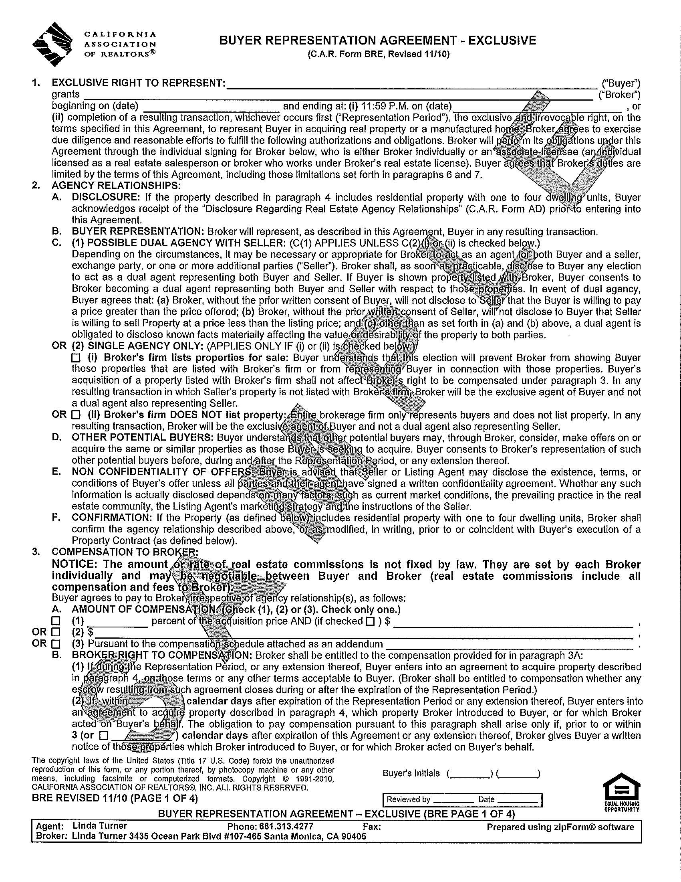

Slide 22
EXCLUSIVE REPRESENTATION MEANS THE BROKER/AGENT IS EMPLOYED BY THE BUYER AND WILL WORK DILIGENTLY ON THE BUYER’S BEHALF

Slide 23

Termination
Broker’s Agreement

Slide 24
Buyer’s Brokers/Agents
Commission
-Seller Pays the Buyer’s Commission-

Slide 25

TIPS FOR WORKING WITH AGENTS

Slide 26
1. Agents Work on Commission:
Very few real estate agents work on salary.
Most real estate agents are paid commission.
Agents get paid when transaction closes.
Agents are not public servants.

Slide 27
2. Keep Appointments & Be on Time:
Be respectful
Do not make an appointment with an agent and then forget to show up
Call if you are going to be late

Slide 28
3. Do Not Call The Listing Agent
If You are Working with a Buying Agent:
Listing agents work for the seller, not the buyer.
If listing agents show you the property, the listing agent will expect to represent you.
Listing agents do not want to do the buying agent’s job.

Slide 29
4. Do Not Sign Forms You Don’t Understand:
Ask to be explained a form. Don’t feel silly.
Agents are not lawyer and cannot interpret law.

Slide 30

5. Be Ready to Buy:
If you aren’t ready to buy, you don’t need a real estate agent.

Slide 31
Remember:
Finally, make your home buying experience fun—
Buying a home is a BENEFIT for you
IT IS AN INVESTMENT!!!!

Slide 32
THANK YOU!!!

